Slide 1
Sprint 2
CB06 - group 4
Emanuil Karapachov
Vlad Cojocariu
Stanimir Nikolov
Wondimu Woldeaarggiye

Slide 2
Agenda
Previous Sprint Feedback Review
Concepts vs Reality
Questions/Planning for the next sprint

Slide 3
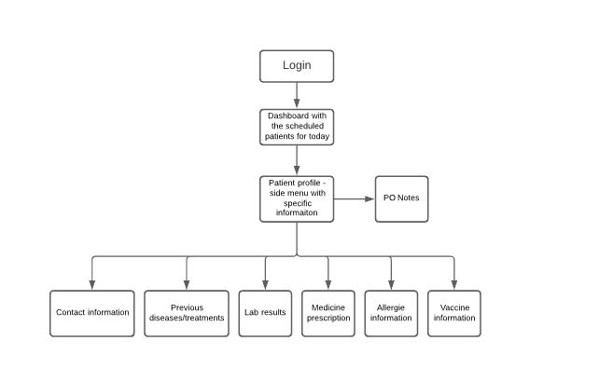
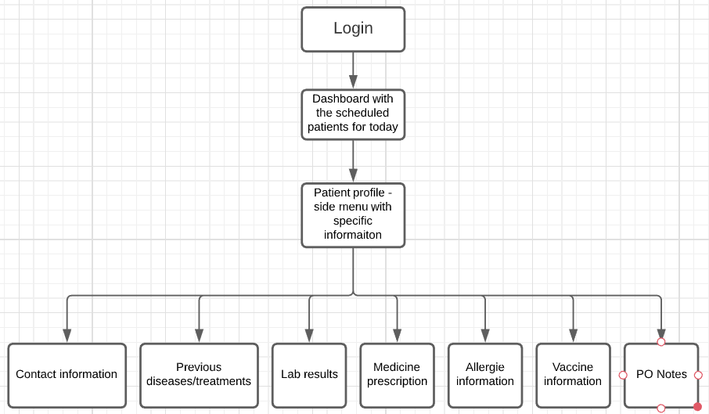
Feedback Review
VS

Slide 4
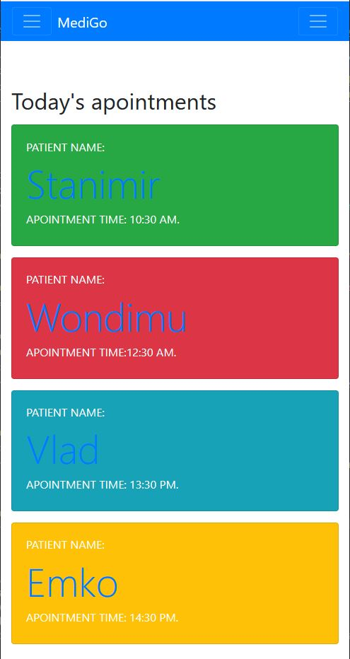
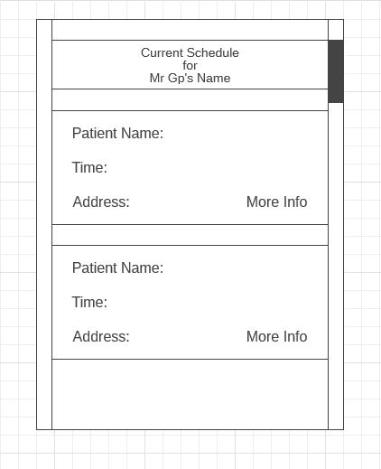
Concepts VS Reality
VS

Slide 5
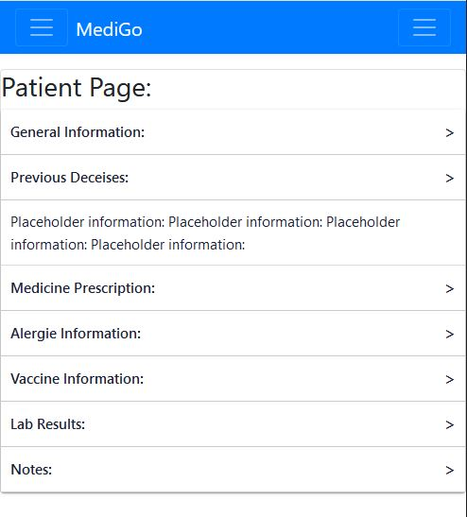
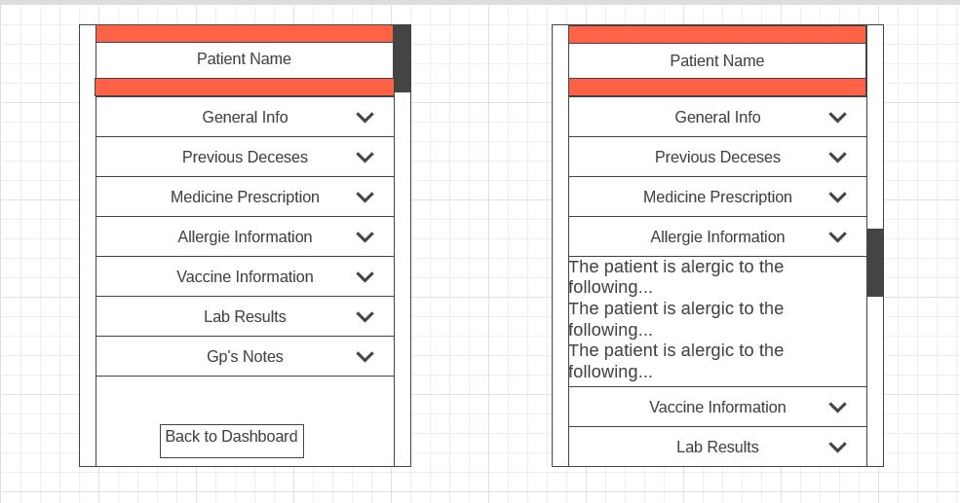
VS

Slide 6

Questions

